Slide 1
Body Organization and Bones

Slide 2
Levels of Organization
Cells: basic unit of structure and function in a living thing
Major parts
Major functions
Tissues: group of similar cells that perform the same function
Organs: composed of different types of tissues
Organ systems: group of organs work together to perform a major function

Slide 3
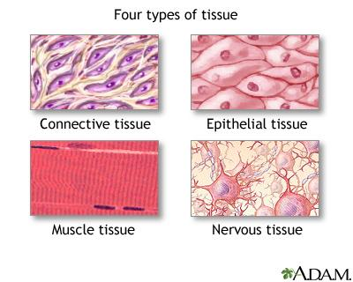
Tissues
Muscular
Contract or shorten, movement
Nervous
Directs and controls processes
Brain, spinal cord, and nerves
Connective
Provides support for your body and connects parts
Bones and fat
Epithelial
Skin and lining of organs
Protects what lies beneath

Slide 4
Organ Systems
Circulatory or cardiovascular: transports materials to and from cells
Digestive: breaks down food and absorbs nutrients
Nervous: detects information from the environment and controls functions
Skeletal: supports and protects the body
Endocrine: controls many body processes by means of chemicals
Respiratory: takes in oxygen and eliminates carbon dioxide
Excretory: removes wastes
Muscular: enables movement of the body and organs

Slide 5
Homeostasis
Body’s tendency to keep an internal balance
Or internal environment is kept stable in spite of changes in the external environment
Examples:
Body temp. 37 degrees C or 98.6 degrees F
Sweating-evaporation of sweat uses heat
Shivering-muscle contractions produce heat
Stress-reaction of your body to potentially threatening, challenging, or disturbing events
Increase breathing
Adrenaline gives you a burst of energy so you can take action

Slide 6
Skeleton
Newborn has 275 bones
Adult has 206 bones
Vertebrae (backbone) has 26 bones
Function:
Shape and support
Movement
Protection
Production of materials like blood cells
Storage of calcium and phosphorus

Slide 7
Joints of the Skeleton
Place in the body where two bones come together
Two main types:
Immovable joints
Little or no movement
Ex: skull
Movable joints
Allow a wide range of movements
Ligaments: connect bone to bone in joints
Cartilage: found in between bones and protects them from rubbing against each other

Slide 8
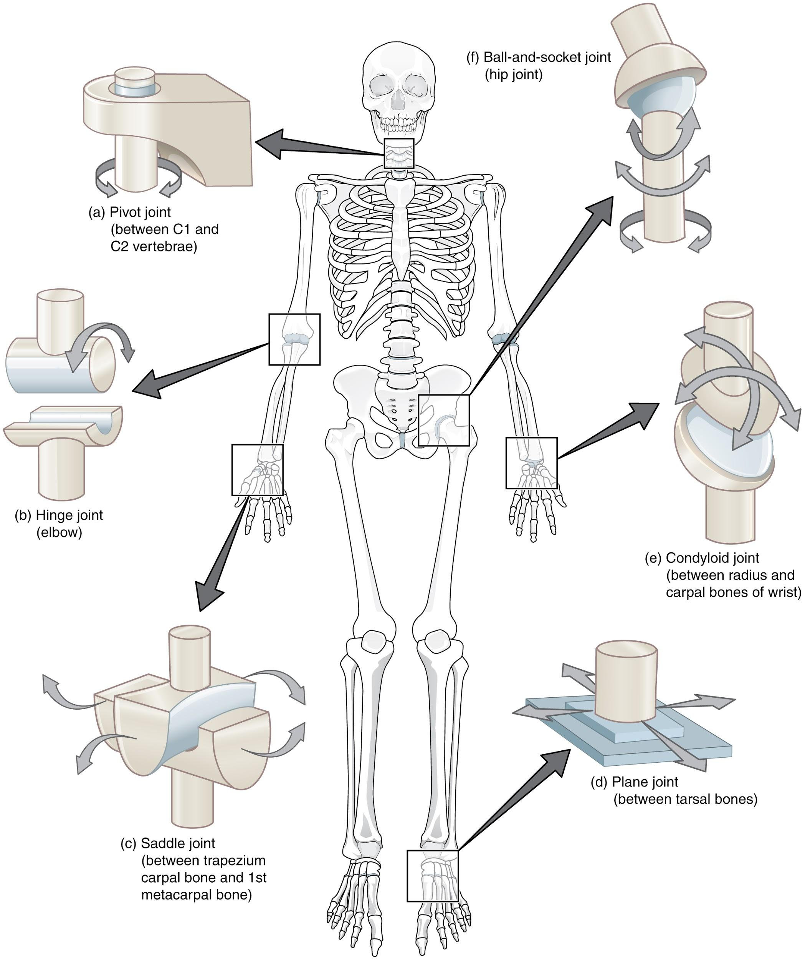
Types of Movable Joints
Hinge joint
Allows forward and backward motion
knee
Ball and socket joint
Greatest range of motion/Move freely in a circle
Shoulder and hip
Pivot joint
Allows one bone to rotate around another
Neck
Gliding joint
One bone to slide over another
Wrist and ankle

Slide 9
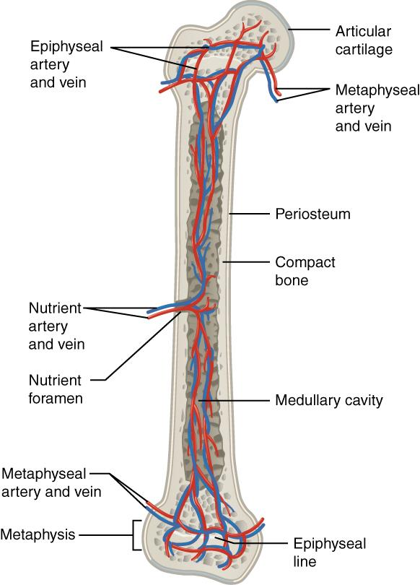
Bones Structure
Compact bone
Hard and dense
Have canals with blood vessels and nerves
Spongy bone
Many spaces
Lightweight, but strong
Found at ends
Marrow
Red-produces blood cells
Yellow-stores fat
Bone growth

Slide 10
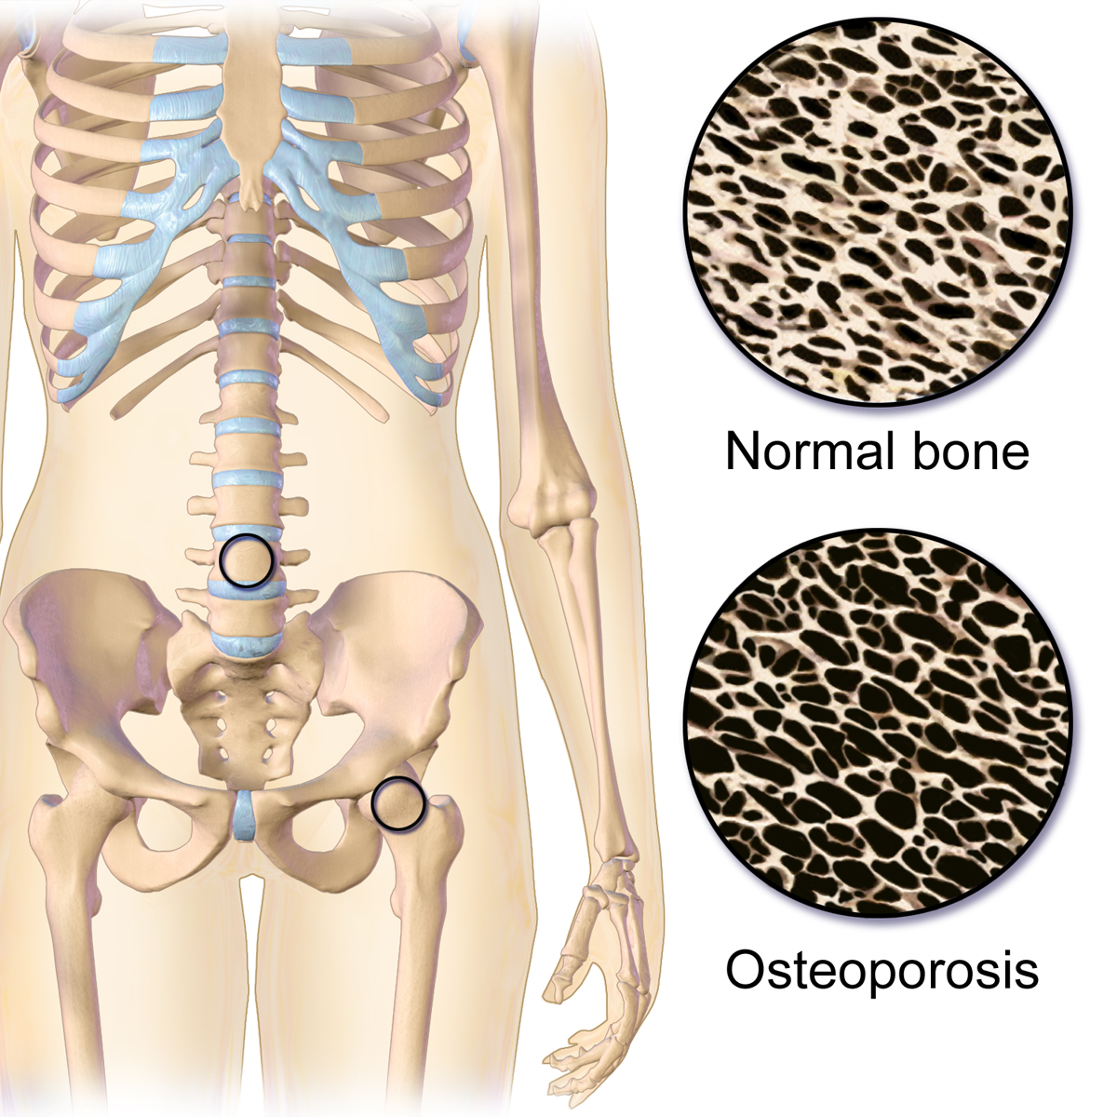
Taking Care of Your Bones
Healthy bones
Balanced diet that includes enough calcium and phosphorus
Exercise
Weight bearing activities help bones grow stronger and denser
Osteoporosis
A condition in which the body’s bones become weak and break easily
Loss of minerals specifically calcium
More common in women

Slide 11
Common Skeletal System Injuries
Fracture
Break in a bone
Simple-cracked or completely broken into two or more pieces
Compound-broken ends of bone stick out through the skin
Dislocation
When the end of a bone comes out of its joint
Sprain
Ligaments are stretched too far and tear in places
Most common joint injuries
Cause swelling

Slide 12
Identifying Injuries
X-rays
Form of energy that travels in waves
Pro’s:
inexpensive
Con’s:
Can only see hard bone injuries
Damage your body cells
MRI’s
Magnetic resonance imaging
Large machine that contains electromagnets
Causes atoms in body to vibrate
Computer analyzes vibration patterns
Pro’s:
Sharp and clear image of hard and soft tissues
No evidence of cell damage
Cons:
expensive

Slide 13
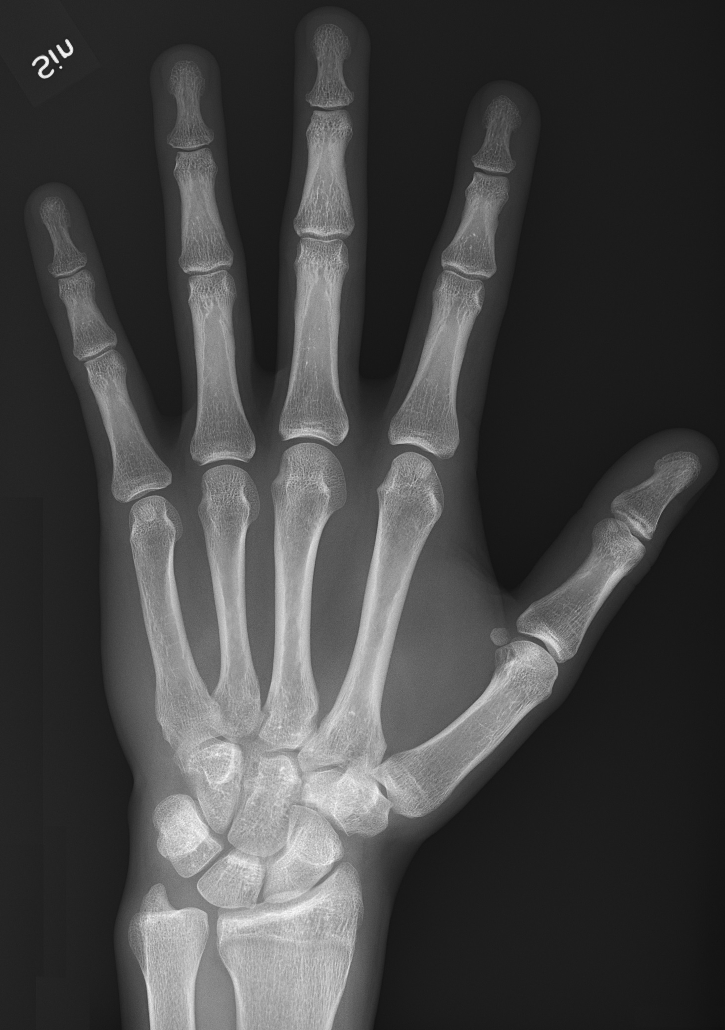
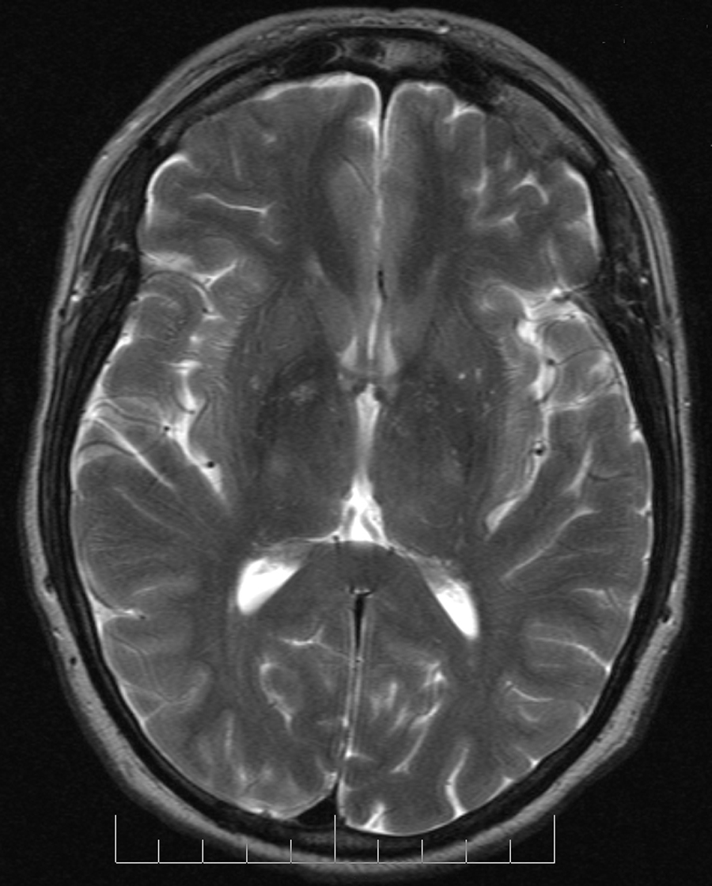

Slide 14
Treating Injuries
Casts
Surgery
Joint replacement
Arthritis-a disease of the joint that makes movements painful
Replace with artificially made one made of metal or plastics
Arthroscopy
Small incision and insert a slim, tube-shaped instrument
Camera and tools at end

