Slide 1
Mesopotamian Empire

Slide 2
First Empires
Sumer’s strength faded
Northern Mesopotamia and neighboring Syria built empires.
Empire- group of many different lands under one ruler

Slide 3
Who Was Sargon?
Ruled kingdom of Akkad in northern mesopotamia
Ambitious leader
Moved his army south and conquered city-states one by one
Empire lasted more than 200 years

Slide 4
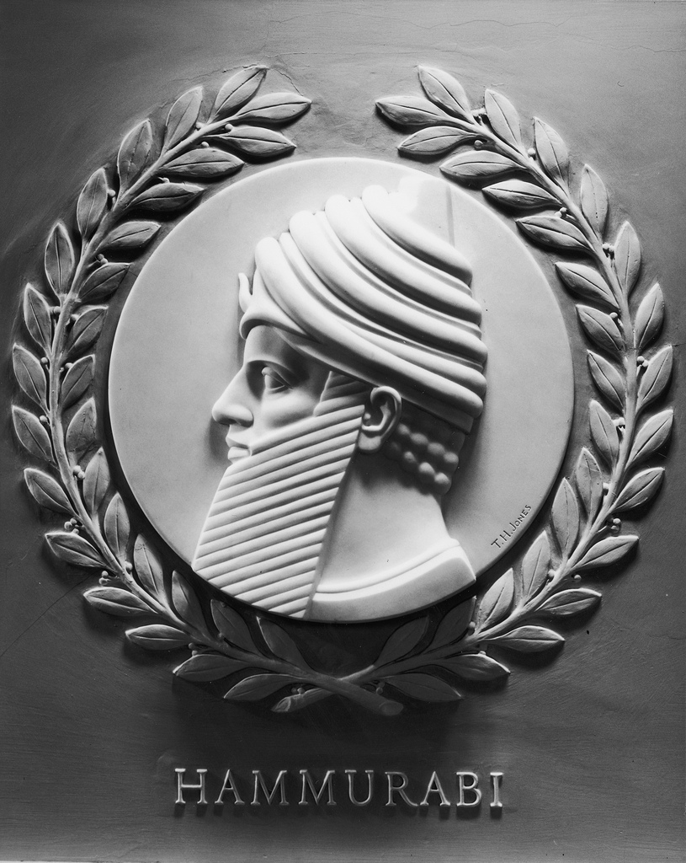
Who was Hammurabi?
Amorites in the west conquered all of Mesopotamia and built their own cities.
Babylon was the grandest of these cities.
Created the Babylonian Empire

Slide 5
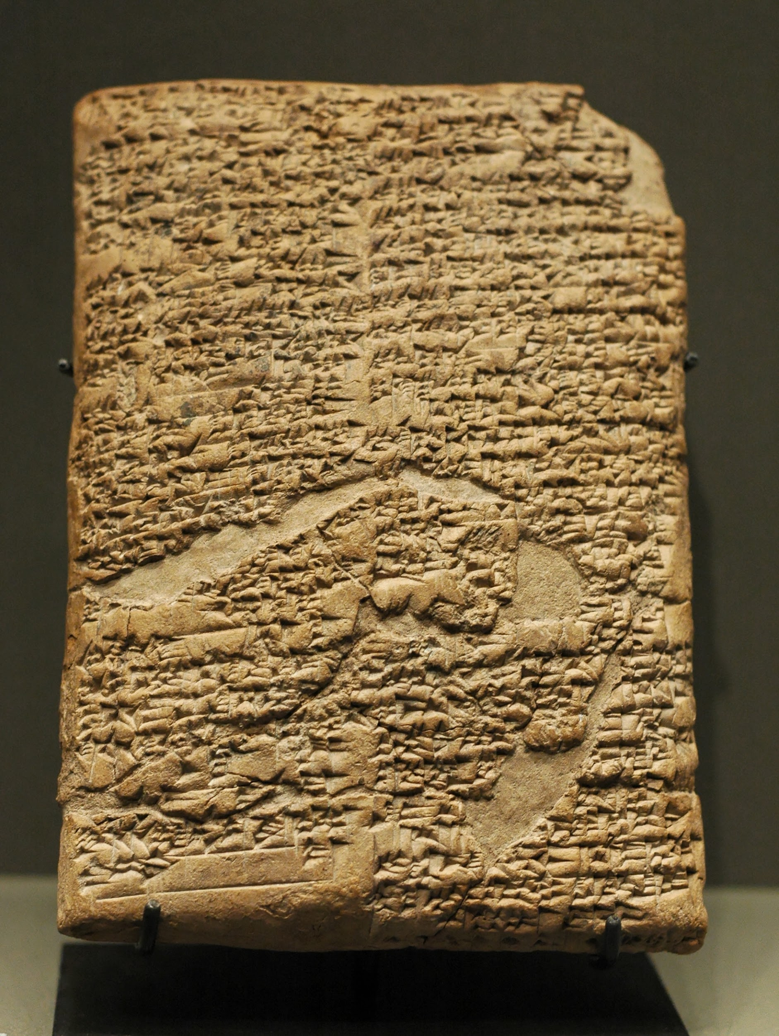
Hammurabi’s Code
Wanted to be a just ruler
Created a set of laws for his empire
Posted laws so all could see
Code death with crimes, farming, business, marriage and family as well as punishments for each
Strict
Known as “eye for an eye, and tooth for a tooth”
Meant to limit punishment and do away for blood feuds
Protected the less powerful

Slide 6
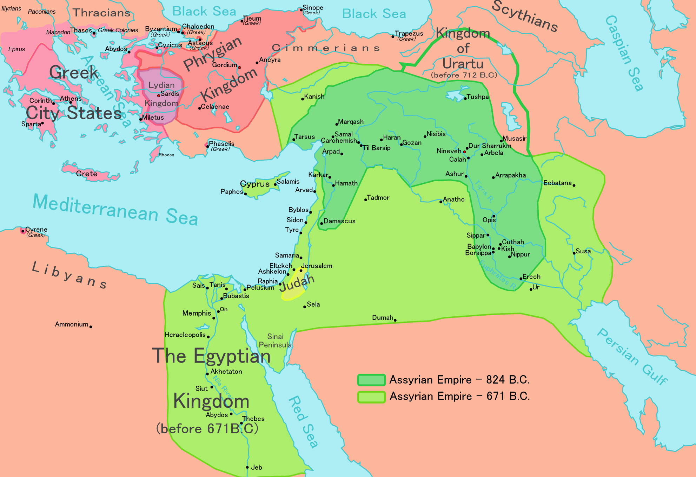
Assyrian Empire
About 1000 years after Hammurabi
Large empire that extended into Turkey, Syria, Iran, and Iraq
Built a large and powerful military to defend their hills and fertile valleys

Slide 7
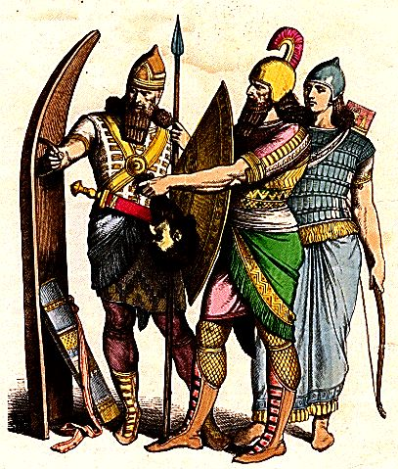
Assyrian Army
Well trained and disciplines
During battle
50,000 soldiers
Infantry or foot soldiers, cavalry or horse soldiers, and charioteers
Fought with slingshots, bows and arrows, swords, and spears
Robbed people, set fire to crops, and destroyed towns and dames
Took tribute or forced payments from conquered people
Drove people out of home
So afraid, people would surrender without a fight.
Key to success: iron weapons
Learned technology from Hittities

Slide 8
Kings and Government
Capital was Nineveh
Empire divided into provinces or political districts
Built roads to connect them
King chose officials to govern, collect taxes and carry out laws
Soldiers stood guard at stations on roads to protect traders from bandits.
Messengers rested at stations and change chariot horses.

Slide 9
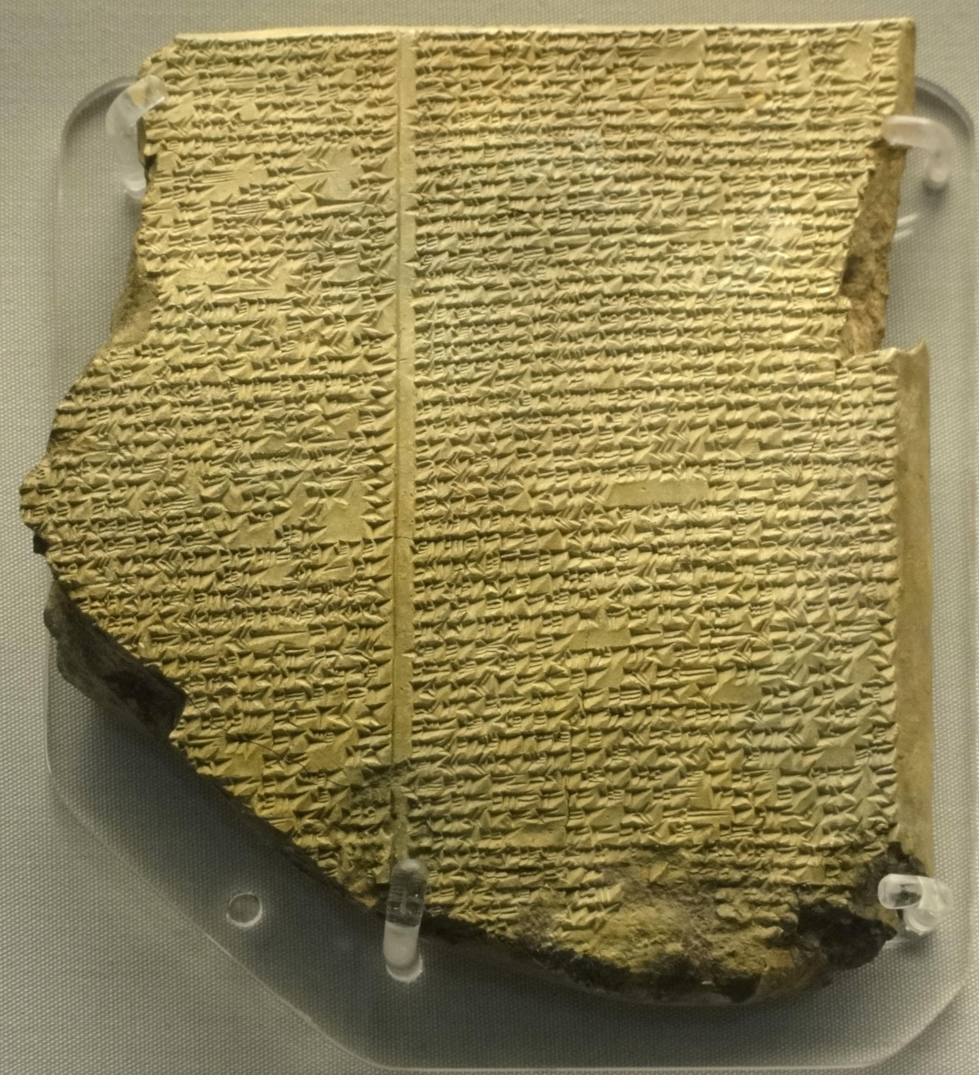
Life in Assyria
Laws and codes were harsher than those of Mesopotamia
Assyrians based writing on Babylonian writing and worshiped similar gods.
Built temples and palaces with wall carvings and statues
Wrote and collected stories
Brought in wood and metal from far away
Ashurbanipal
Built first library
Held 25,000 tablets of stories and songs to gods

Slide 10
Chaldean Empire
Because of harsh rules, people often rioted.
Around 650 B.C., Chaldeans took power
They had been under Assyrian rule since 1000 B.C.
Nabopolassar decided to reclaim his kingdom.
Within a year, he had forced Assyrians out of Uruk and he was crowned king of Babylonia
Medes people also joined Chaldeans
Nabopolassar’s son Nebuchandnezzar helped create empire.
Son rebuilt Babylon
City of Babylon served as capital.
Called the New Babylonian Empire.

Slide 11
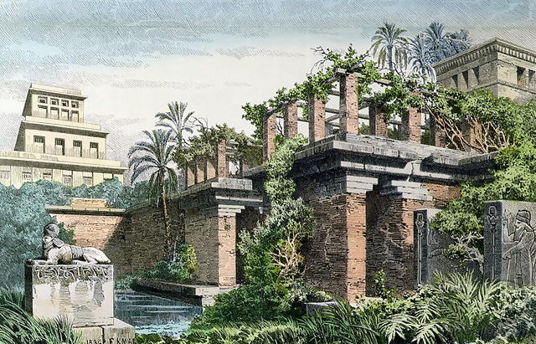
Greatness of Babylon
City of Babylon
Huge brick walls surrounded city
Soldiers kept watch in towers that were built into the walls
Grand palaces and temples at the center
Huge 300+ ft ziggurat with gold roof
Roads paved with limestone and marble
Palace had a giant staircase of greenery known as the Hanging Garden
7 Wonders of the World
Terraced garden (huge steps)
Large trees and masses of flowering vines
Complex irrigation system

Slide 12
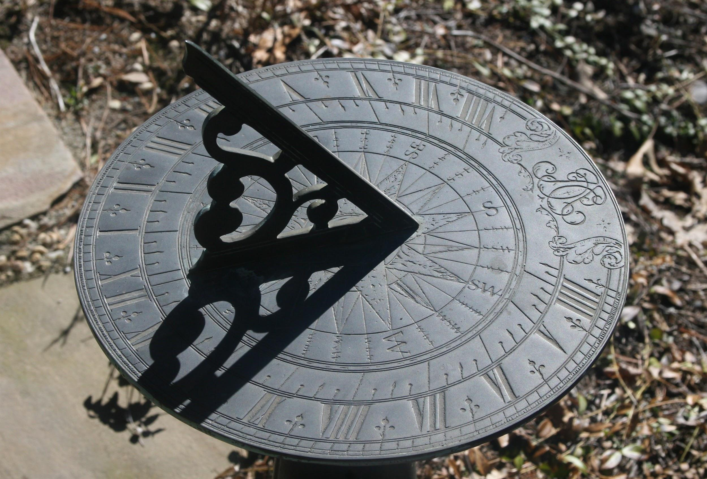
Greatness of Babylon
Ceremony in spring
Statue of Marduk was wheeled down city
Believed this ceremony would bring peace and bigger crops
Built canals to make land more fertile
Had to collect high taxes and tributes to pay for projects and army
Caravans
Brought pottery, cloths, baskes, and jewelry
Scientific achievements
Believed gods showed their plans in the changes in the sky
Astronomers or people who study the heavenly bodies
Mapped stars, planets, and the phases of the moon
Invented sundials to measure time
Follow a seven day week

Slide 13
Fall of the Empire
After Nebuchadnezzar died
Weak kings ruled
Poor harvests and slow trade weakened empire
Persians captured Babylon

