Slide 1
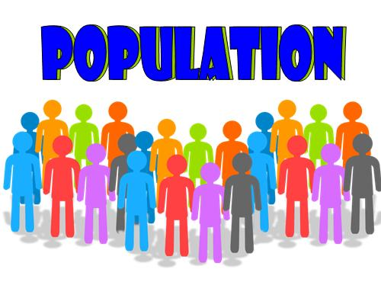
Populations and Communities

Slide 2
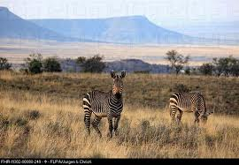
Habitats
Organism- living thing
An environment that provides the living things the organism needs to live, grow and reproduce is called its habitat.
What does an organism need from its environment?
Food
Water
Shelter
Other things

Slide 3
Biotic vs. Abiotic Factors
Biotic Factors
Living parts of an environment
Plants
Animals
Fungi
Bacteria
Abiotic Factors
Nonliving parts
Water
Needed to carry out all life functions and makes up of most parts of body (humans 65%)
Photosynthesis
Sunlight
Oxygen
Needed to carry out life functions
Temperature
Soil
Mixture of rock fragments, nutrients, air, water, and decaying remains

Slide 4
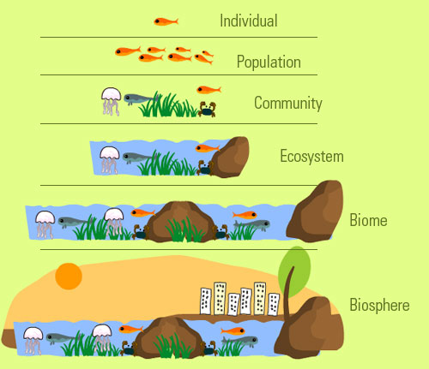
Levels of Organization
Organism
Species-group of organisms that are physically similar and can mate with each other and produce offspring that can also mate and reproduce
Population-all members of one species in a particular area
Community-all the different populations that live together in an area
Ecosystems-community and all abiotic factors in environment
Biosphere-all living areas on earth
Ecology

Slide 5
Determining Population Size
Direct observation
Indirect observation-observe signs of organisms like nests
Sampling (estimates based on reasonable assumption)
Mark-and-recapture studies

Slide 6
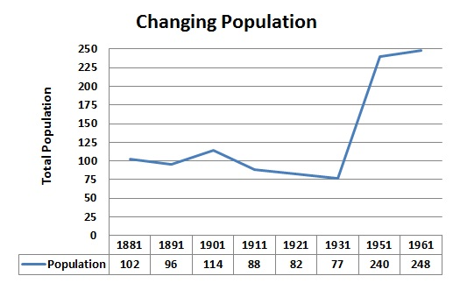
Changes in Population Size
Birth rate
Death rate
Population statement
If birth rate is greater than death rate, population size increases.
Immigration-moving into
Emigration-leaving
Graphing changes
Population density=
Number of individuals
Unit Area

Slide 7
Limiting Factors
Environmental factor that causes a population to decrease
Food and water
Carrying capacity-largest population that an area can support
Space
Determines whether the plant can obtain the sunlight, water, and soil nutrients it needs
Weather conditions
Temperature and amount of rainfall

Slide 8
Adapting to the Environment
Natural selection-process where a characteristic that makes an individual better suited to its environment may eventually become common in that species
Adaptations-behaviors and physical characteristics that allow organisms to live successfully in their environments
Niche-role of an organism in its habitat and how it makes its living
Type of food
How it obtains its food
Which other organisms use the organism for food
When and how the organism reproduces
Physical conditions it requires to survive

Slide 9
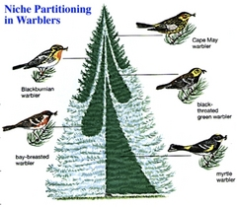
Competition
Struggle between organisms to survive as they attempt to use the same limited resource
Food
Water
Shelter
Warbler specializes
In feeding

Slide 10
Predation
Interaction in which one organism kills another for food
Predator-does the killing
Prey-organism that is killed
What is the effect on population size?
More predators?
Less prey?

Slide 11
Adaptations
Predator adaptations
Cheetah: runs fast
Jellyfish: poisonous tentacles
Sundew plant: stick bulbs so when a fly lands it gets stuck
Owls: eyes to hunt at night
Bats: locate prey using ecolocation (sound)
Prey adaptations
Alertness and speed of antelope
Skunks: spray
Mimicry:
worm looks like a snake
Protective covering:
Pine cone, turtle
False coloring
Butterfly wings with eyespots
Warning coloring
Bright colors warn of poisons
Camouflage
Walking leaf insect

Slide 12
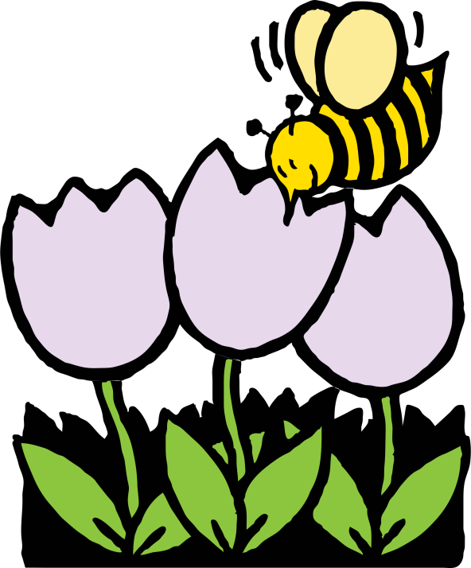
Symbiosis
Mutualism
Relationship in which both species benefit
Bats and saguaro cactus flowers
Bats get food
Saguaro cactus pollen is carried to other plants
Acacia trees and stinging ants
Ants nest in trees that have thorns that discourage predators
Ants attack other animals that approach trees and clear competing plants

Slide 13
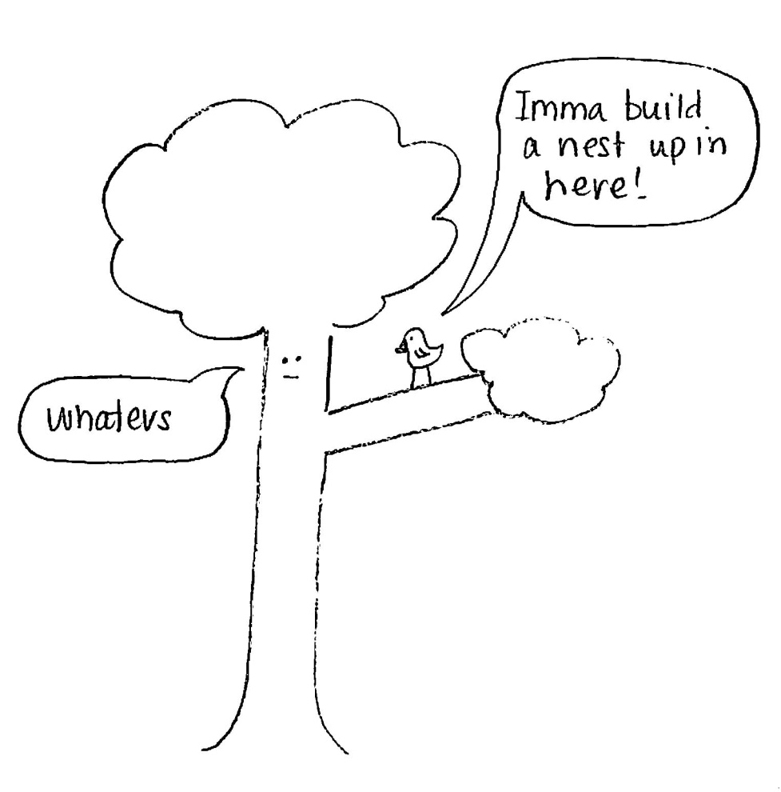
Symbiosis
Commensalism
Relationship in which one species benefits and the other species is neither helped nor harmed
Hawks and saguaro cactus
Hawks build nests

Slide 14
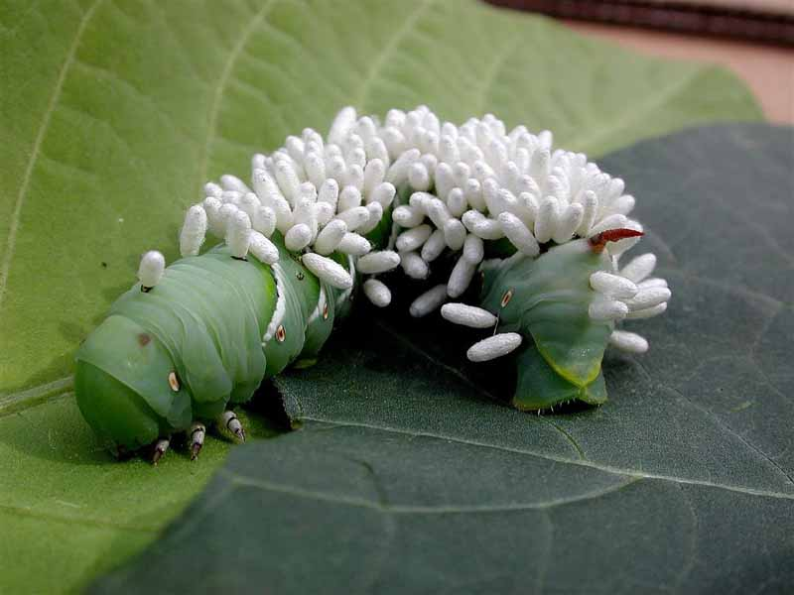
Symbiosis
One organisms living on or inside another organism and harming it
Parasite-organisms that benefits
Fleas, ticks, leeches, and tapeworms
Host-organism that is harmed

Slide 15
Changes in Communities
What can change communities quickly?
Fires
Floods
Volcanoes
Hurricanes
Other natural disasters
What is succession?
Series of predictable changes that occur in a community over time

Slide 16
Primary Succession
Series of changes that occur in an area where no soil or organisms exist
New island formed by an eruption
Area of rock uncovered by melting ice
Pioneer species-first species to repopulate
Carried by wind or water
Mosses or lichens (fungi + algae)
Help break up rocks
When they die, they provide nutrients that enrich the soil
Soil creation occurs
Plant seeds land on new soil and grow.
Reaching a mature community may take centuries.

Slide 17
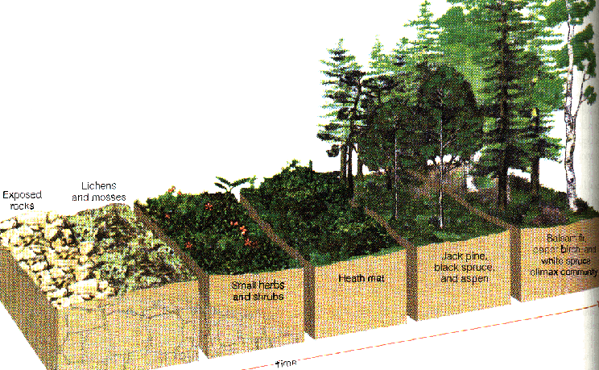

Slide 18
Secondary Succession
Series of changes that occur in an area where the ecosystem has been disturbed, but where soil and organisms still exist
Natural disturbances: fires, hurricanes, tornadoes
Human activities: farming, logging, or mining
Occurs more rapidly
Example:
Abandoned field- grasses and wildflowers take over
Tree growth begins
Forest develops
Mature community

